Slide 1
System Based Online Exam System
PROJECT BY
BHARAT SUNEEL 141112014 ASHUTOSH KUSHWAHA 141112029
SANKET KUMAR GAUTAM 141112022
ABHIJEET RAWAT 141112110
VANSH KUKREJA 141112108

Slide 2
Vision Of The Project
This project is the college level project and is implementing under the guidance of college professors. This project is useful for creating a Virtual Environment for conducting various types of Exams like Programming Exams, Subjective and Objective Exams etc.

Slide 3
Introduction
The product is supposed to be open source. It is a software implementing e-portal for conduction of exam. The exam system provides Interactive and User friendly Interface for exams management.
The following are the main features that are included in this software :
Cross platform support
User accounts
Large Number of users being supported by the system:
Ecofriendly
Input Data Validation

Slide 4
Objective
Quick scheduling:
The system helps the faculty member to generate an onscreen exam instead of using papers, Which save a time for writing, checking and for input marks. Also, student can see the exam when he login as an individual to the system.
Immediate results and solutions :
When the student finishes his exam, the system checks his/her answers and compares with the correct answers stored in the database and immediately computes and shows the result on screen.
Easy to store and retrieve information :
Rather to save the information on a papers or in separate sheets, there is data base management to store and retrieve the information needed by the administrator, instructor or student.
Easy feedback to students to improve themselves:
The instructor can easily provide feedback to the students, he can give personalized exams/tests to the students to improve themselves.
Result Analysis of an Exam In an Efficient Manner:
The exam system provides instructor an opportunity to take the overview of a given exam in a graphical manner in the form of graphs and charts. The Quick and efficient analysis is easy to understand and may be helpful to improve the performance of class as well as individual students respectively.
Proper collection of data of an individual –
New method of restricting input fields in signup in certain restricted way, so that data can be entered with preciseness and incorrect data may be rejected.

Slide 5
Present systems
Present exam Systems are there yet they lack due to following reasons---
Limited no of user connected to database
Multiple user interaction at single time lead to improper functioning of the project
Less no of data verification techniques.
Breakage of signal during exam time
Less interactive environment may lead difficulty to user to use the software.

Slide 6
Processed systems
The extra functionality that is in the project is data validation .
Environment for giving objective type paper is quite interactive and easy.
Result analysis may be helpful in the evaluation of the progress that is going or the efforts that are needed to improve it.
Even if data base fails the program will work on user level in instructor side updating the source code disadvantage is only that large amount of memory will be wasted.

Slide 7
Scope Of The Project
The purpose of the software is to provide an Interactive and easy Exam Interface to the students so that they can write their exams easily. This software will also have Personalized User Interface, which will make the use of the software very easy.

Slide 8
Functionalities
The functionality of each module is as follows:
a. Candidate module: The candidate will login to the software and take his examination. He can also check his previous examinations marks and his details.
b. Instructor module: The database is prepared & loaded into the software. Selection for examination can be done language wise by the examiner. The results will be displayed immediately after completion of the examination.
c. Administrator module: The administrator collects all the results after successful completion of the examination and sends to the server as and when required.
The features available to the Students/Candidates are:
Can view the different categories of Test available in their account.
Can change password.
Can view their marks.
Can attain Mock/Practice Test.
Can view and modify its profile but can modify it to some limited range.

Slide 9
Functionalities
The features available to the Instructor are:
Can do the analysis of the different categories of test given by students.
Can change password.
Can view their marks.
Can conduct any type of exam(Objective)
Can view and modify its profile but can modify it to some limited range.
Can set and edit questions, date, time limit for a particular exams.
The features that are available to the Administrator are:
The administrator has the full-fledged rights over the exam system.
Can assign/remove a instructor/student to a group.
Can access all the accounts details of the faculty members/students.
Can view the details of a particular group.
Can hide any kind of features from the both of users.
Insert/delete/edit the information of available on exam system.

Slide 10
Targeted Audience
Users of the system should be able to retrieve exam related information as and when required. The system will support three types of user privileges, Administrator, Instructor and Student. Students and Instructors will only have access to their functions, while administrator has the privilege management functions.
The Student
Ability to read and understand English.
Familiarity with the operation of the basic Graphical User Interface (GUI) components of the operating system.
The Instructor
Familiarity with the operation of the basic Graphical User Interface (GUI) components of the operating system.
The Instructor users will not be required to have any specific characteristics.
The Administrator
The Administrator users will not be required to have any specific characteristics.

Slide 11
Data flow diagram
ADMINISTRATOR
EXAM SYSTEM
INSTRUCTOR
STUDENT

Slide 12
Methods of the implementation
The above program is implemented in java with the basic concepts of basic purely object oriented programming language java.
Encapsulation, Inheritance ,Abstraction
GUI Handling ,Event handling
Interfaces ,Packages
Multithreading

Slide 13
Hardware requirement
Platform Independent
Processor after Pentinum series for proper response
Wifi / network connectivity
Ram 256 mb

Slide 14
Software requirement
Operating system - Platform independent
Language used - Java standard edition
Database use - Mysql
Requirement – JDK should be installed on the system.
Server/client system

Slide 15
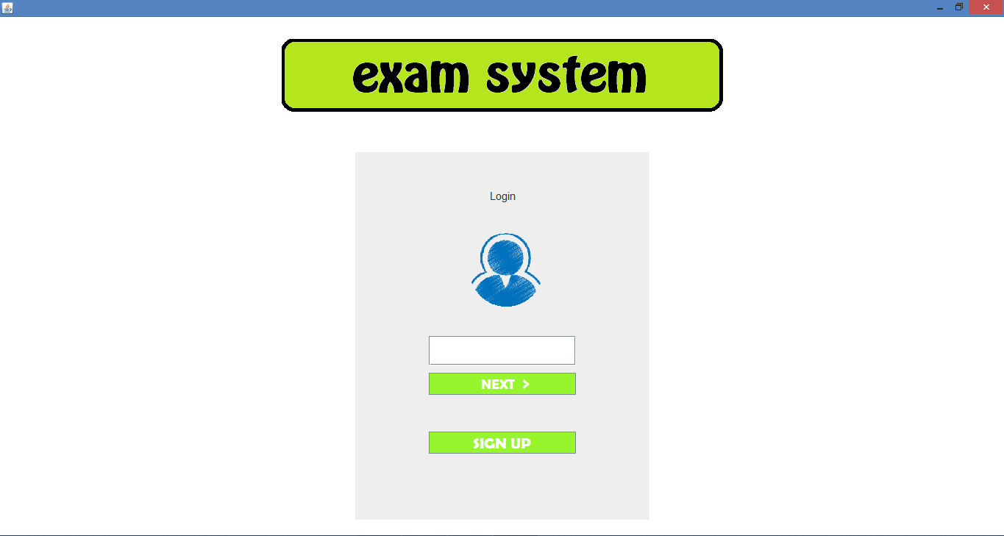
Screenshots

Slide 16
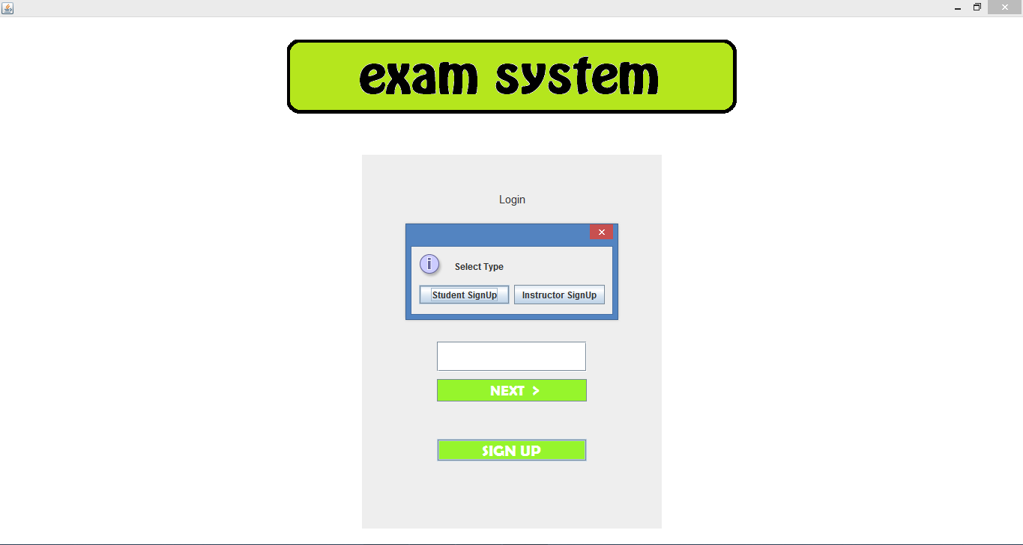

Slide 17
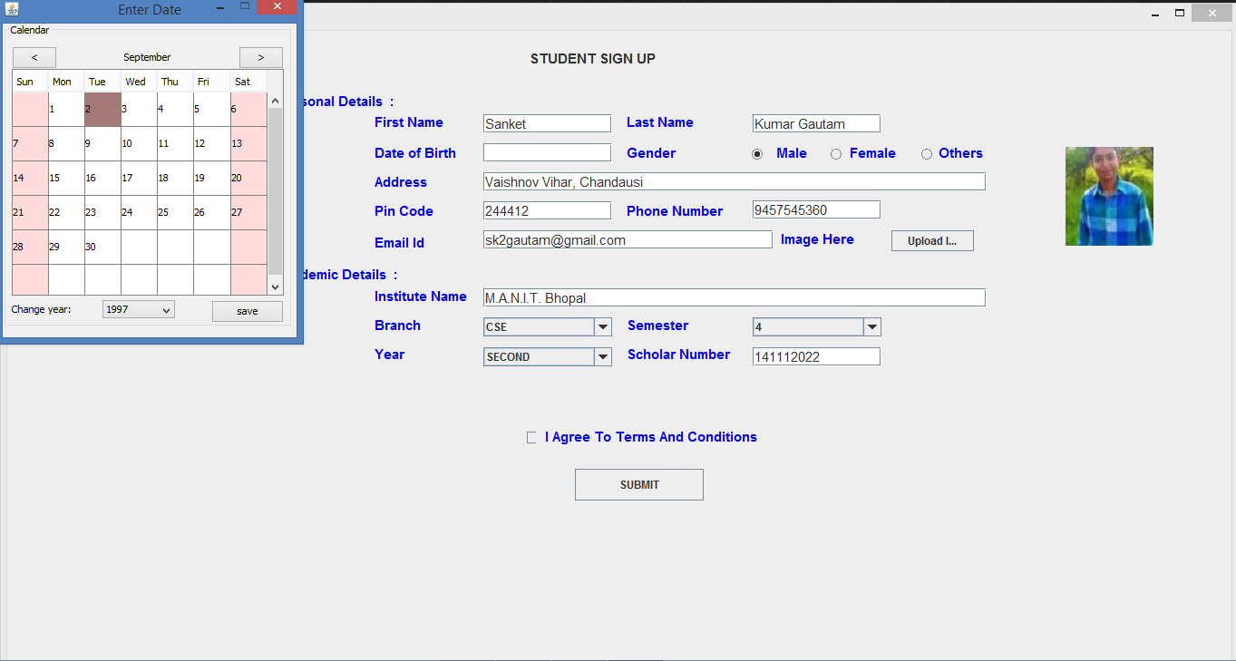

Slide 18
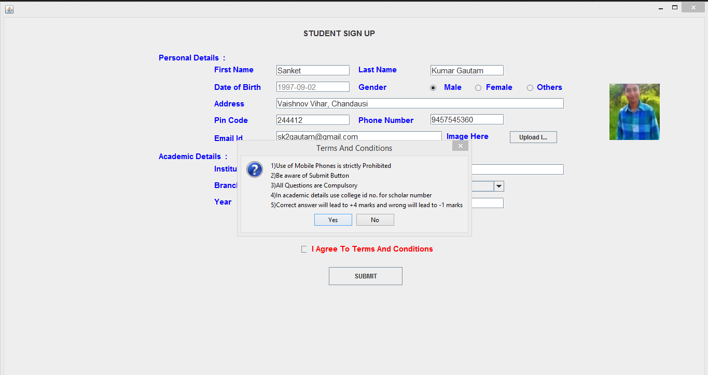

Slide 19
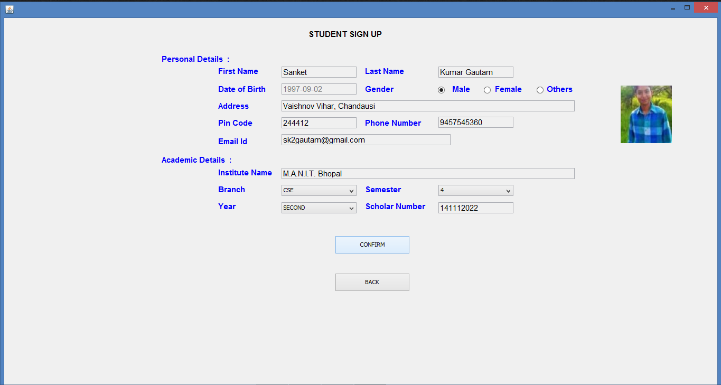

Slide 20
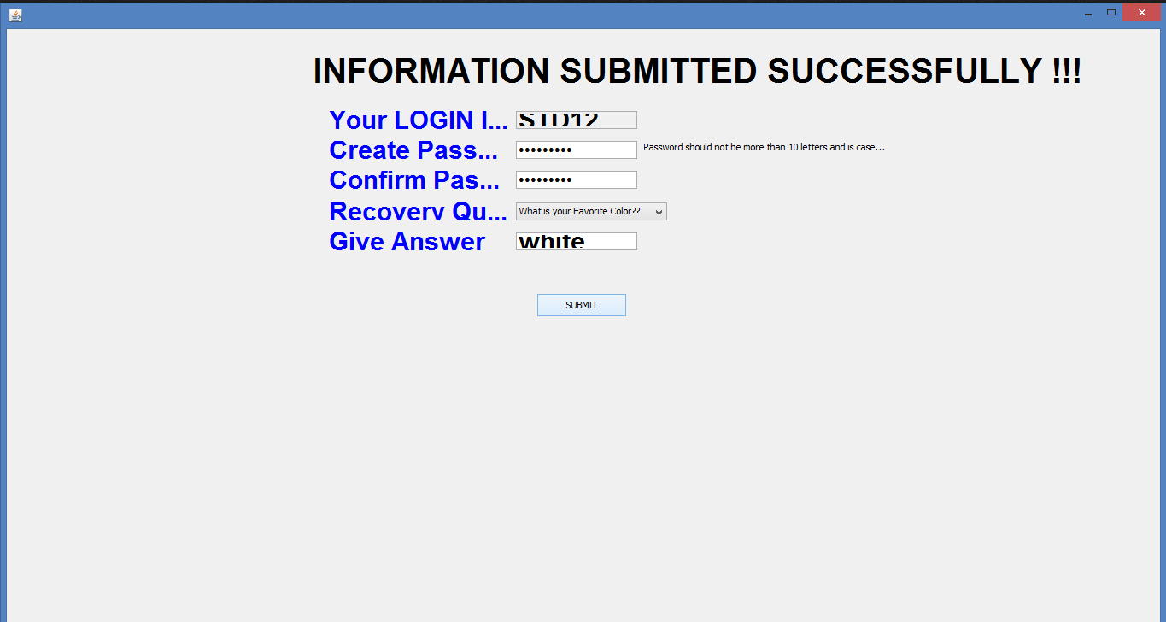

Slide 21
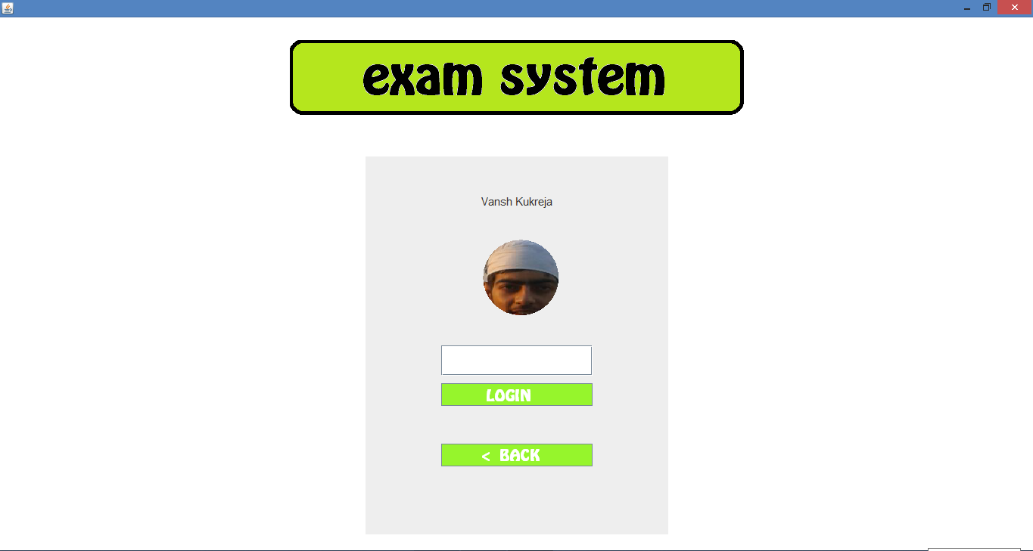

Slide 22
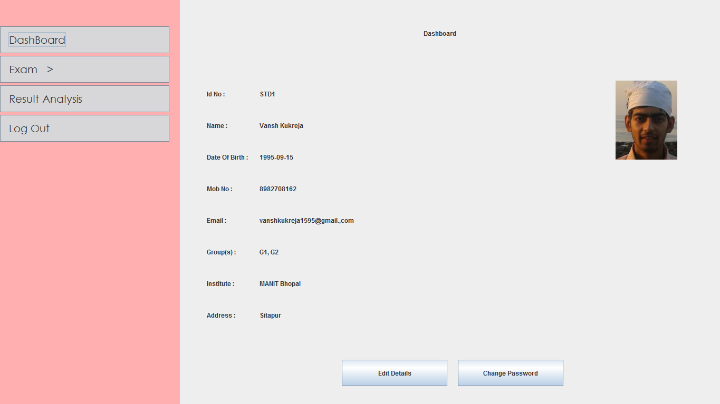

Slide 23
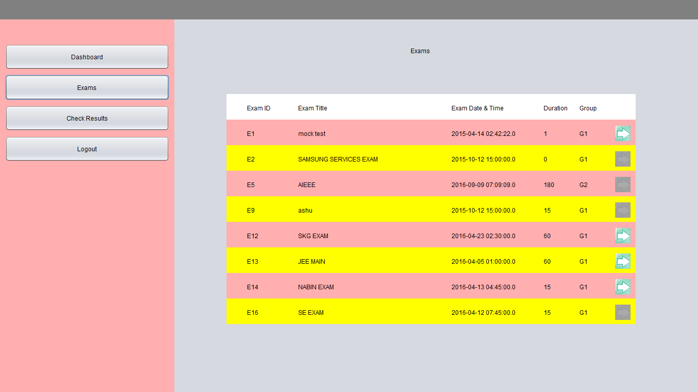

Slide 24
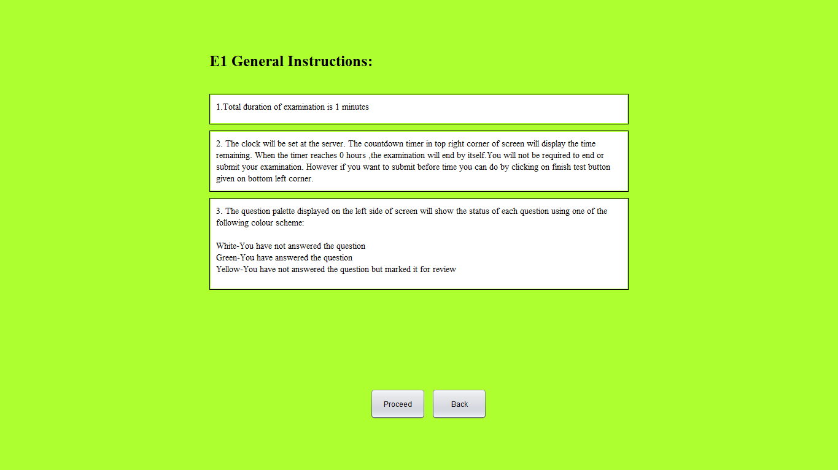

Slide 25
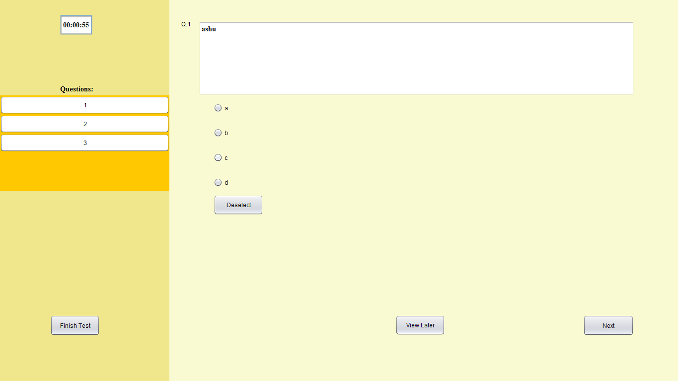

Slide 26
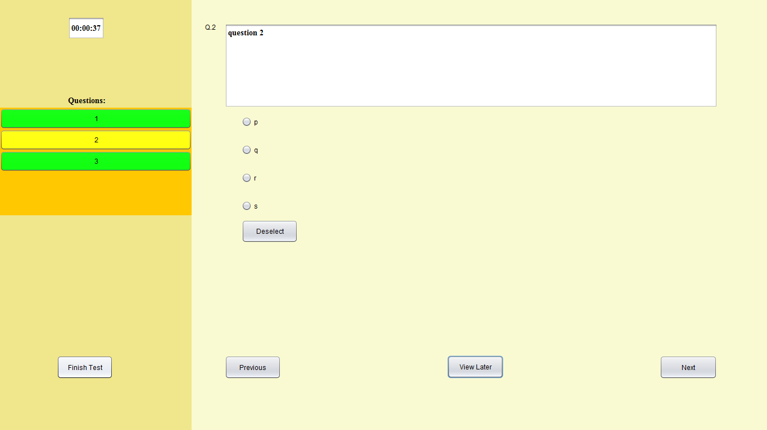

Slide 27
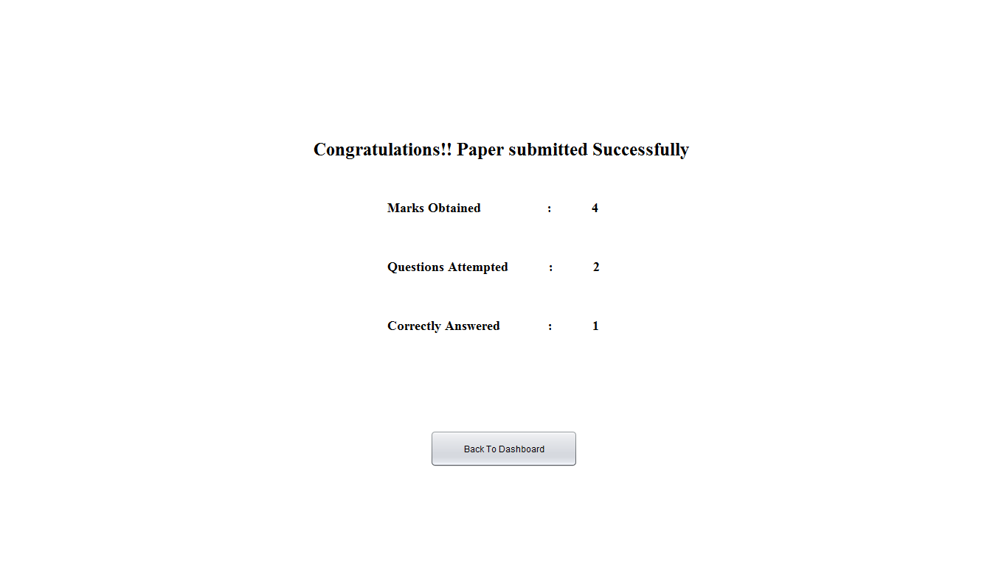

Slide 28
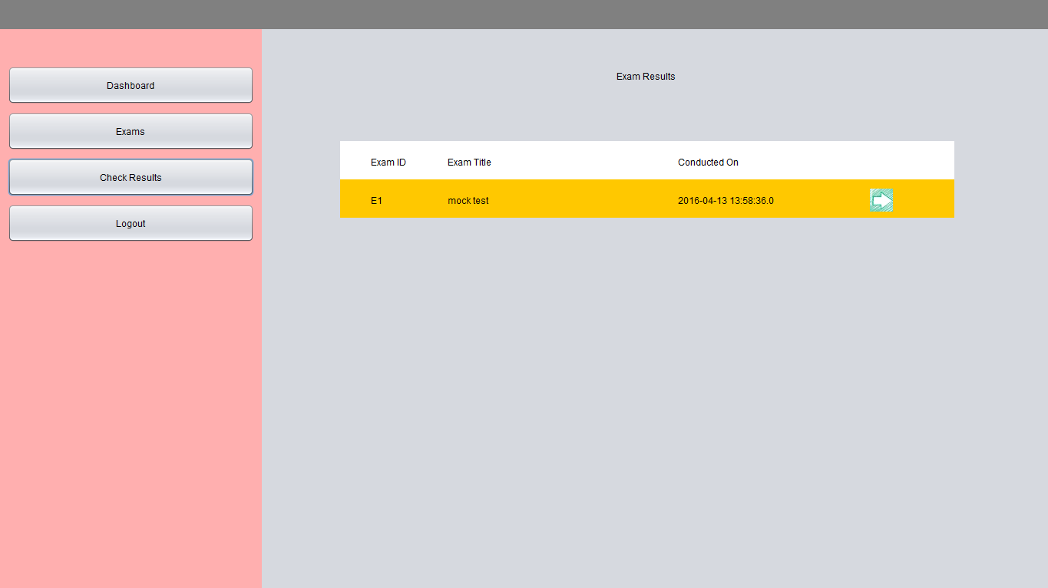

Slide 29
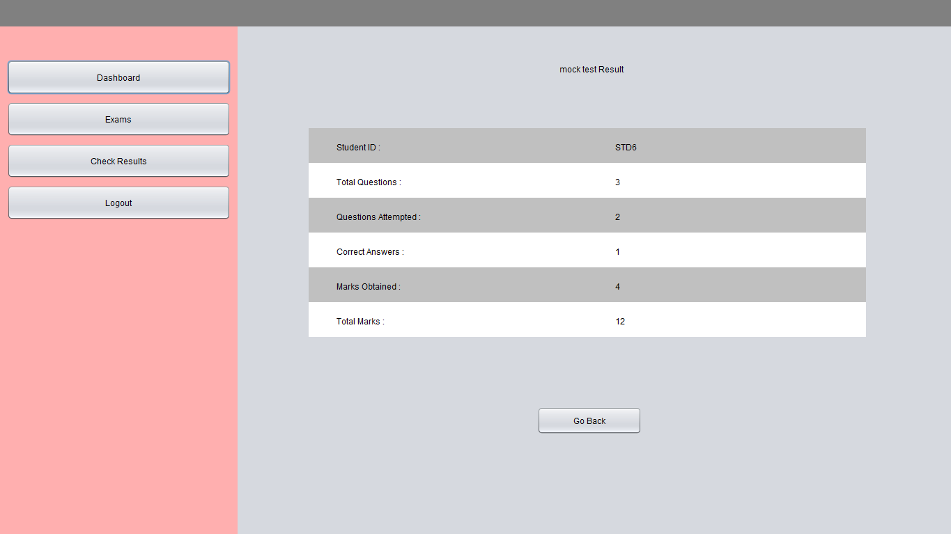

Slide 30
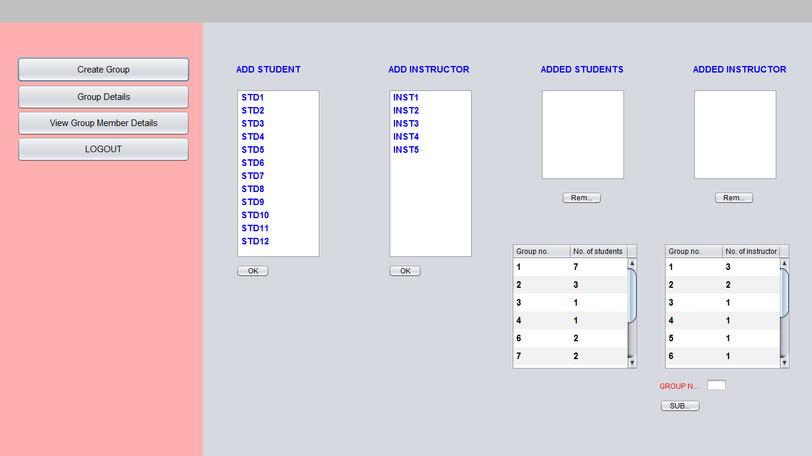

Slide 31
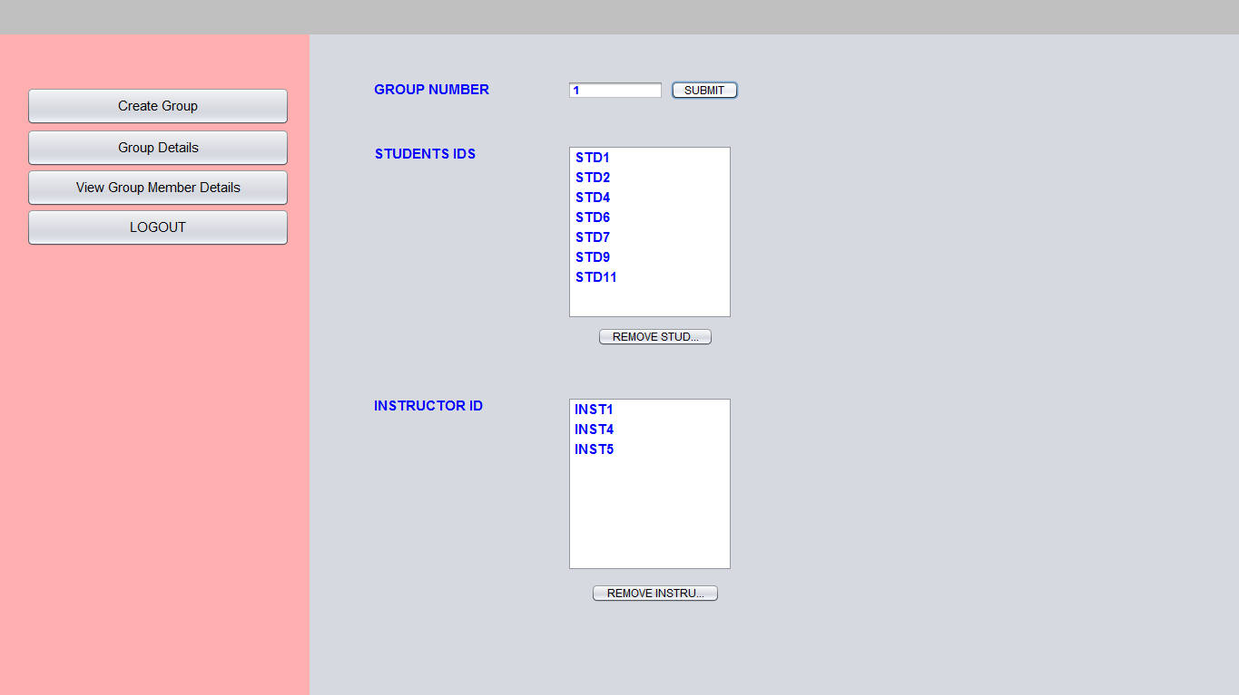

Slide 32
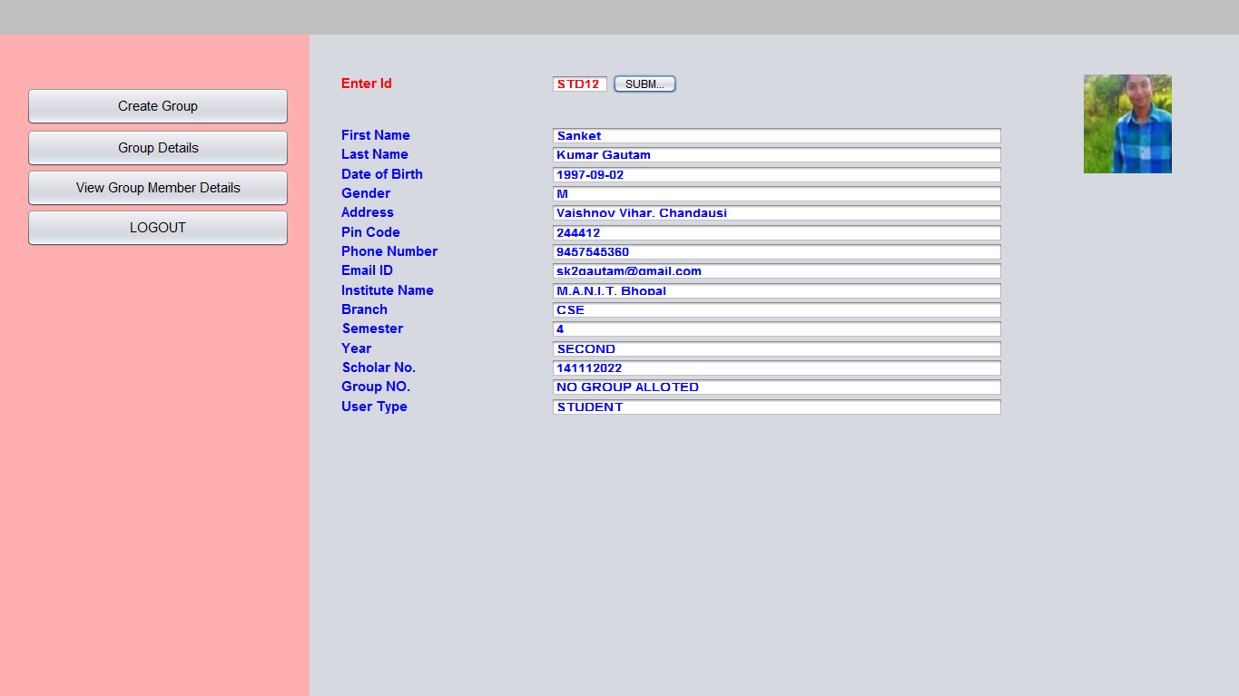

Slide 33
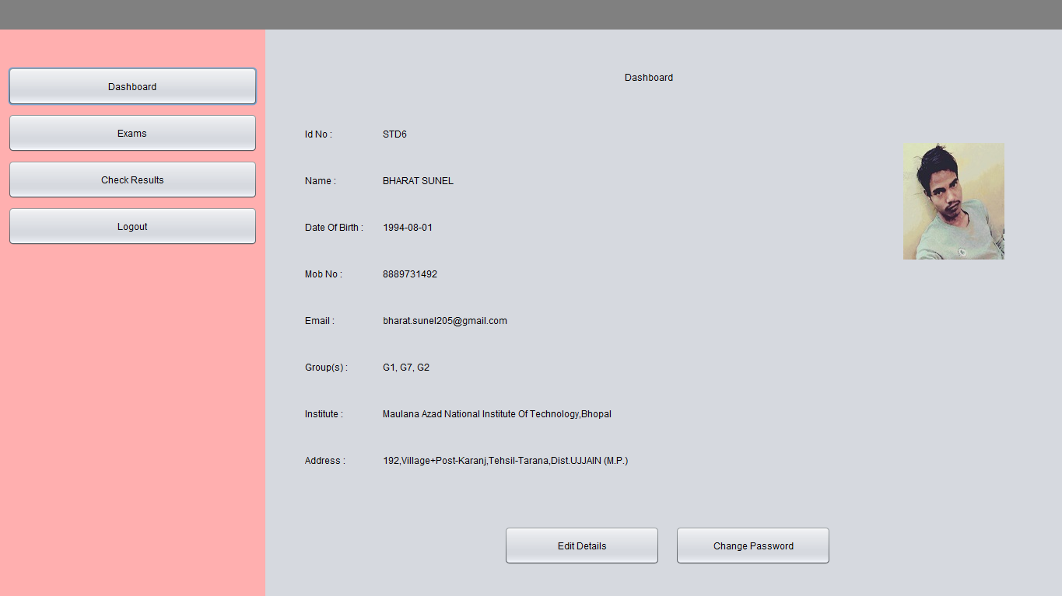

Slide 34
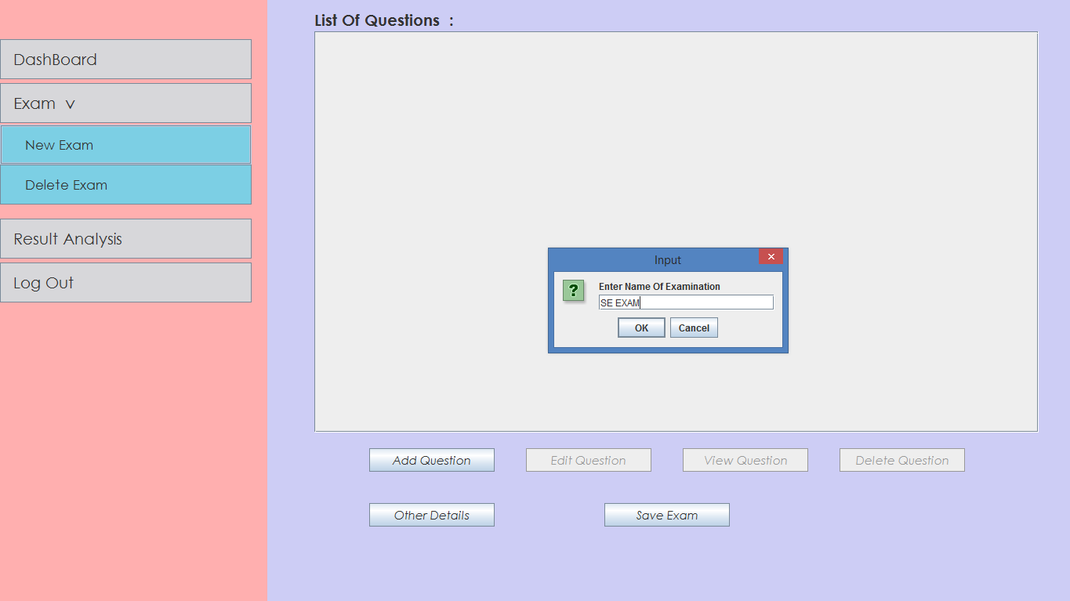

Slide 35
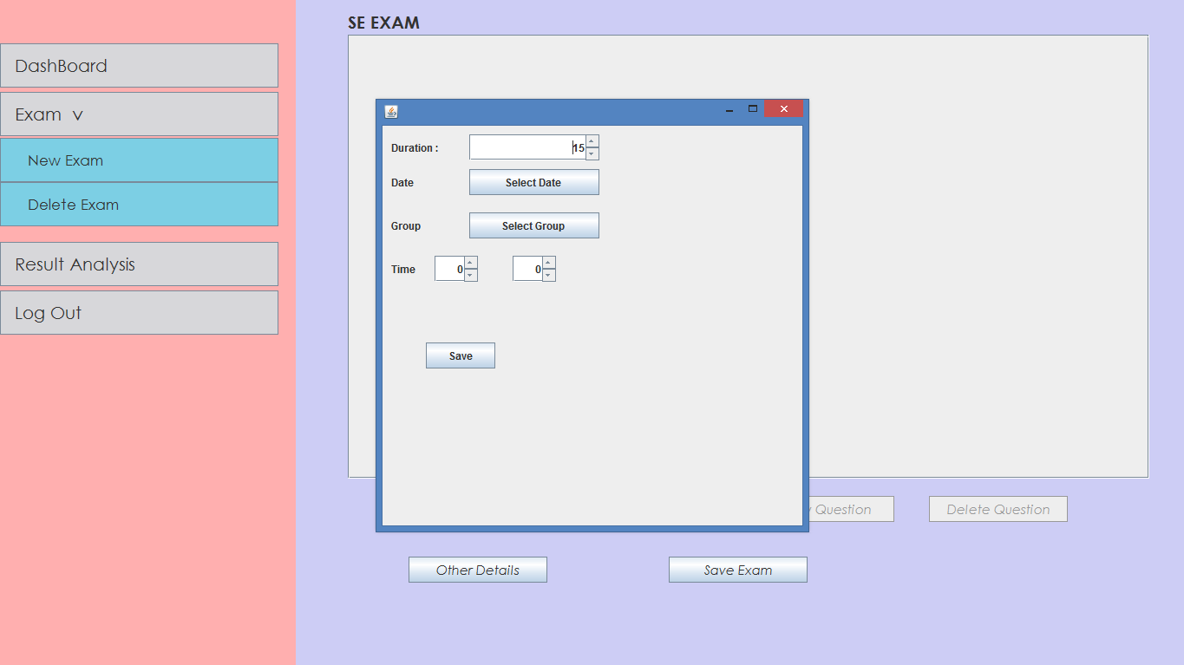

Slide 36
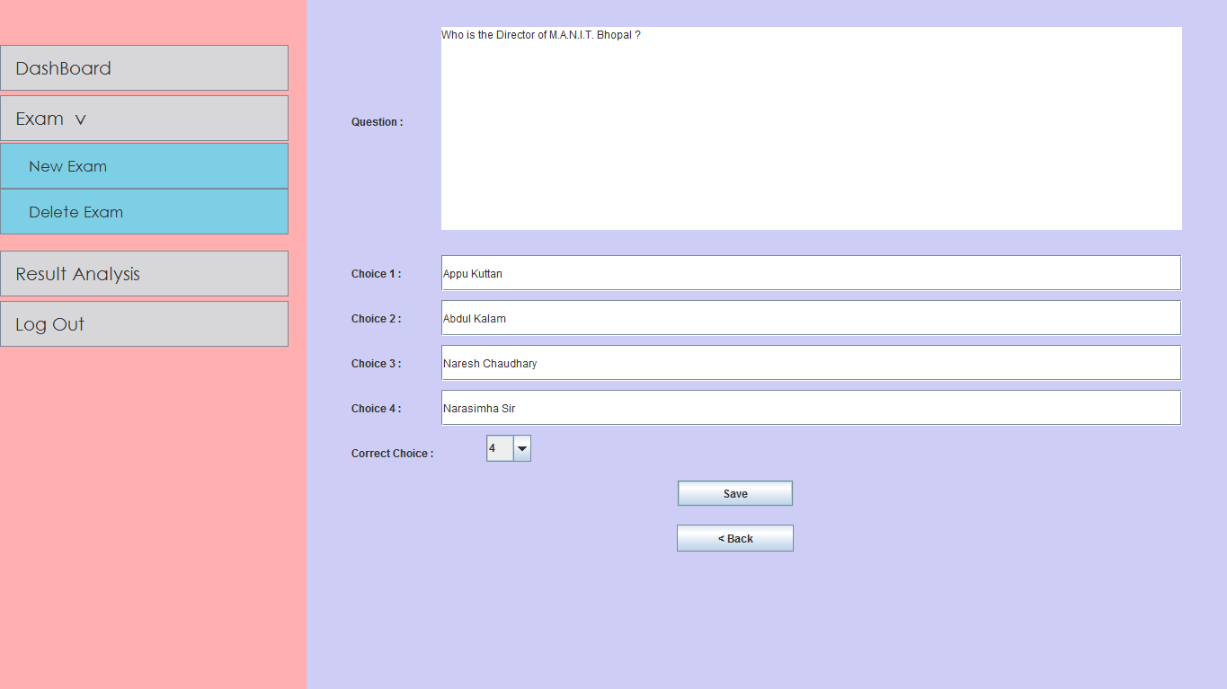

Slide 37
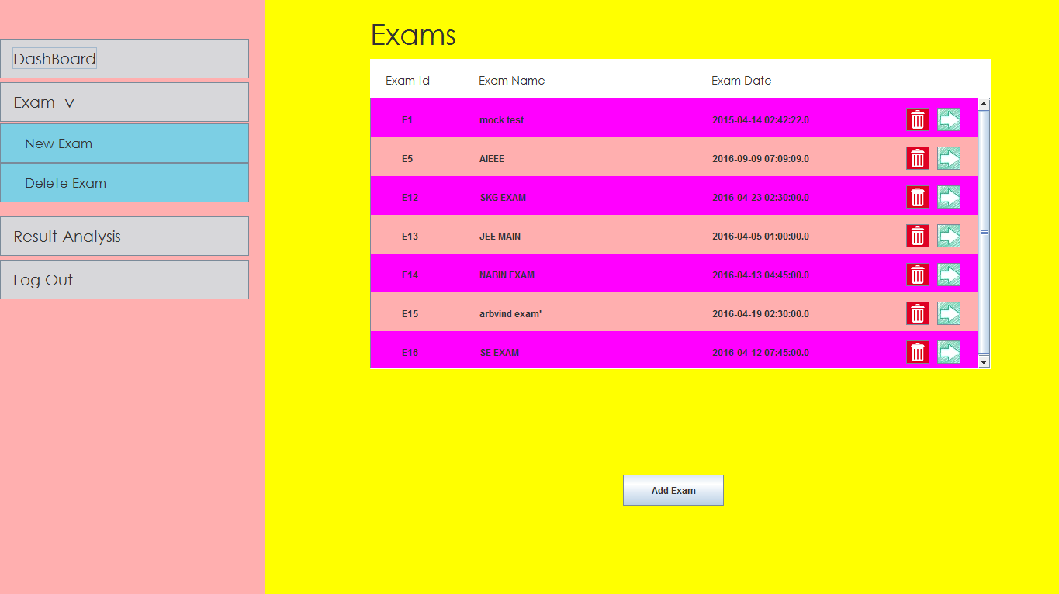

Slide 38
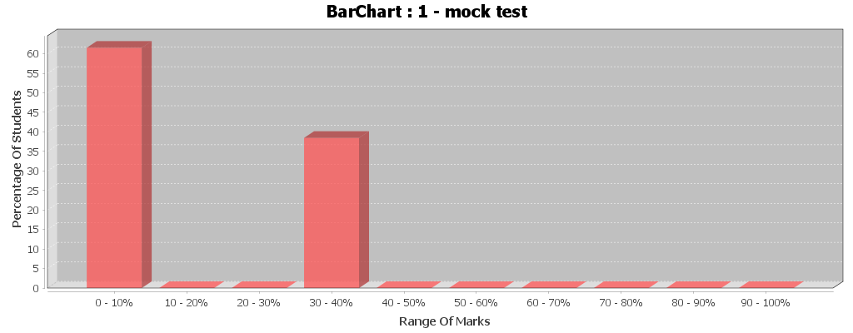

Slide 39
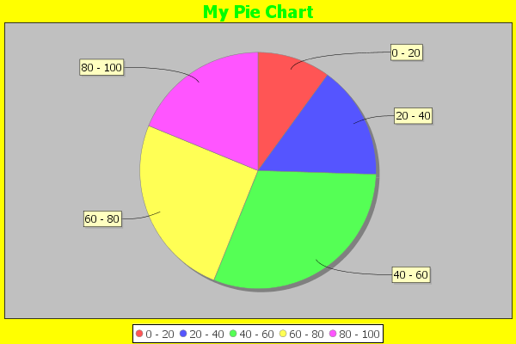

Slide 40
Future Plans
Sending of results to respective email Id of student
Exam consisting of programming ,subjective evaluation.
Introducing interactive ways of data analysis in future versions.
Video monitoring of the student system , during the exam can be done in order to verify that the correct student is giving the exam or to avoid unfair activities during the exam.
The result after the exam will be automatically sent to the email id of the student.
Password retrieval metheology will be based on retrieval from email/otp.
Data verification will be made precise and will be based on image captcha.
Exams will be added that will be programming basis as well as subjective papers.

Slide 41
Thank u

